Slide 1

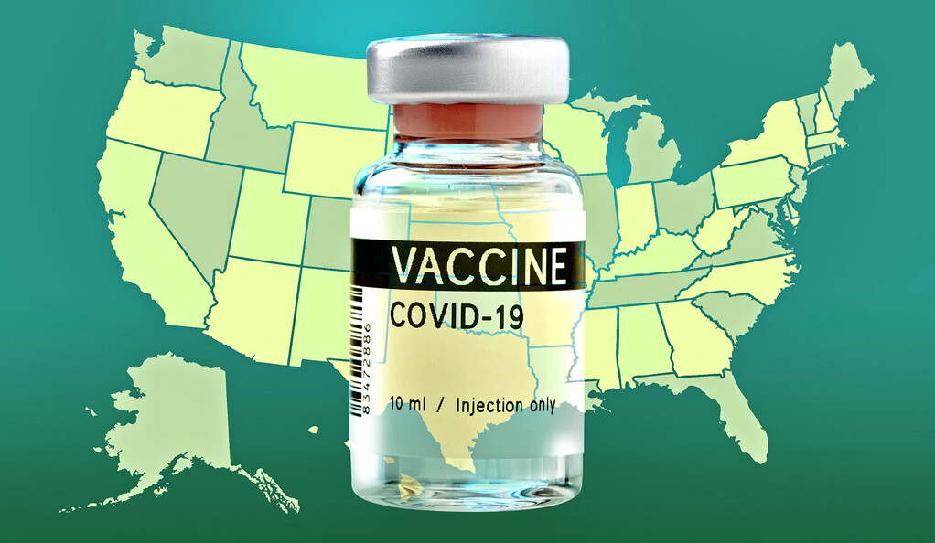
US Vaccine Tracker
Raven Thornton, Ramsha Zaman, Tania Guevara, Whitney Wong

Slide 2
Topic
Our project is to uncover patterns in population vaccinations in USA regarding region, percentage of administered to distributed dosages, age groups.

Slide 3
Questions
1. How many vaccine doses were administered per region?
2. Which region has the highest percent of doses administered (out of doses distributed)?
3. Which vaccine was distributed the most?
4. Which population according to age group has a higher percentage of people vaccinated?

Slide 4
Dataset Selected & Cleaning
Kaggle US Tracker Data:
https://www.kaggle.com/peretzcohen/us-vaccine-tracker
https://github.com/owid/covid-19-data/tree/master/public/data/vaccinations
Repository:
https://github.com/Ramsha2025/US-Vaccine-Tracker-Challenge

Slide 5
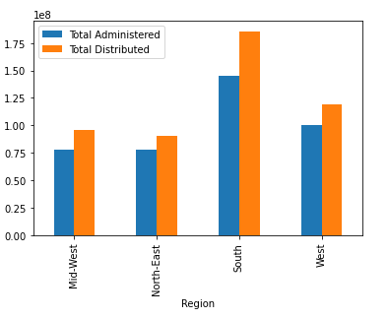
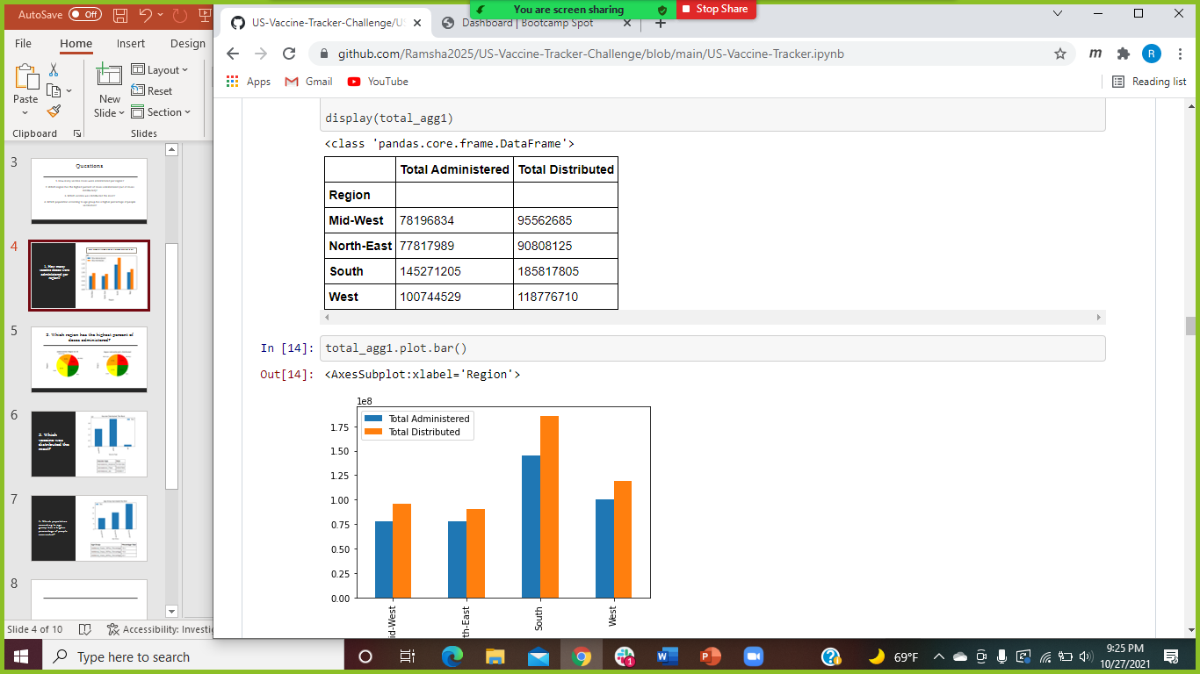
1. How many vaccine doses were administered per region?
Total Administrated and Distributed Vaccine in US

Slide 6
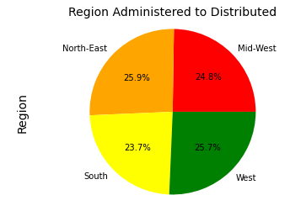
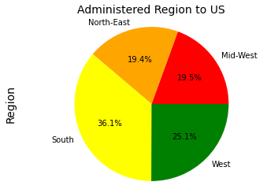
2. Which region has the highest percent of doses administered?

Slide 7
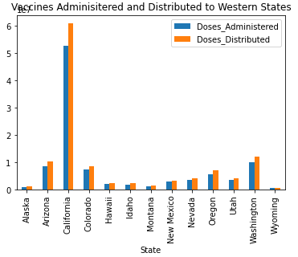
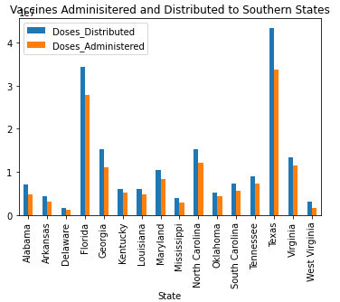
Region

Slide 8
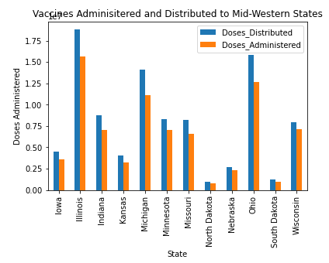
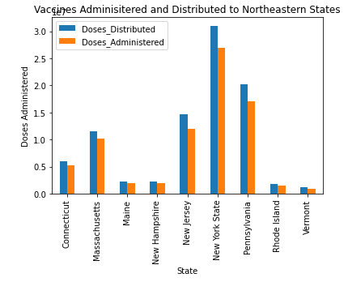
Region

Slide 9
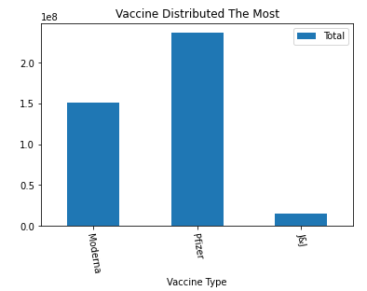
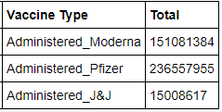
3. Which vaccine was distributed the most?

Slide 10
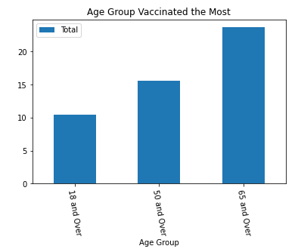
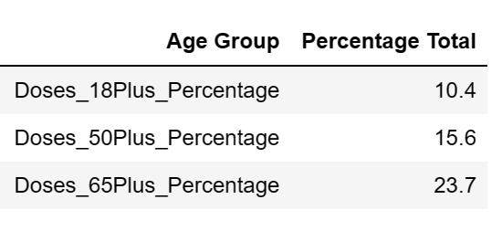
4. Which population according to age group has a higher percentage of people vaccinated?

Slide 11
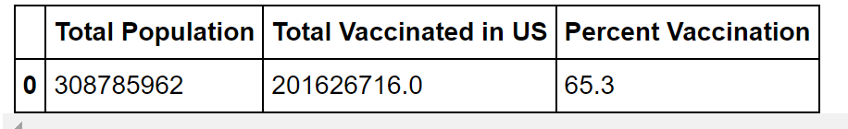
Conclusion
From the data we can conclude…
More people in our US population are getting vaccinated based on age group
Pfizer is on the top of the charts for most heavily distributed vaccine
The NE region had the most vaccines distributed and administered
The South had the most distributed vaccine
Elders, 65 and over, have gotten vaccinated the most

Slide 12
Work Cited
GitHub. 2021. covid-19-data/public/data/vaccinations at master · owid/covid-19-data. [online] Available at: <https://github.com/owid/covid-19- data/tree/master/public/data/vaccinations> [Accessed 20 October 2021].
Kaggle.com. 2021. US Vaccine Tracker. [online] Available at: <https://www.kaggle.com/peretzcohen/us-vaccine-tracker> [Accessed 20 October 2021].

Slide 13
“Eat healthy and do not forget to workout, this is going to build your immunity.”
- Daisy Shah

